Slide 1
Microscopy capstone project lecture 2 classification methods
Support Vector Machine (SVM)
Convolutional Neural Network (CNN)

Slide 2
outline
SVM for imaging classification
CNN for imaging classification
Evaluation metrics (classification report, confusion matrix, vector plot, accuracy plot)
Comparison of the strengths/weaknesses of each algorithm

Slide 3
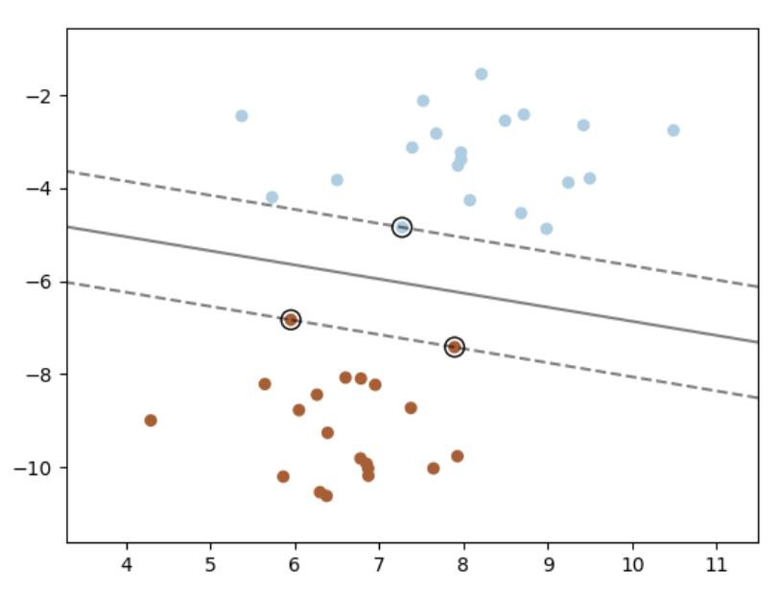
Support vector machine (SVM) overview
Supervised machine learning algorithm
Usually used for classification (can be used for regression)
Data points are mapped into an n-dimensional space plot (n=number of features)
Separates classes by identifying a hyperplane
The line that best separates the classes in the higher dimensional space
Best separation achieved by largest margin between hyperplane and nearest points (support vectors)
SVM are effective in problems when features>>samples
support vector
hyperplane
Scikit-learn

Slide 4
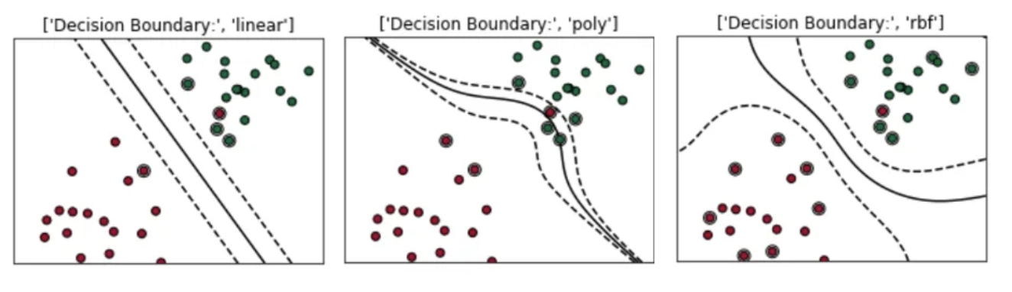



Svm kernels
The SVM kernel is a similarity function to calculate similarity across all data points in a high-dimensional space
Linear kernel
Linearly-separable data
Polynomial kernel
Maps data into a higher dimensional space using polynomial functions
For non-linear problems
Radial Basis Function (RBF)
Maps data into a higher dimensional space using Gaussian functions
For complex non-linear problems
$K\left(xi, xj\right)=γ$ . ($x_{i}^{T}$ $x_{j}$) + r)^{d}
$xi, xj$ = data points
$γ$ = scaling factor
$r$ = optional coefficient
$d$ = degree of polynomial
$$K\left(xi, xj\right)=exp⁡(−γ\left|\left|xi −xj\right|\right|2)$$
$xi, xj$ = data points
$γ$ = Gaussian hyperparameter
$\left|\left|xi −xj\right|\right|2$ = squared Euclidean distance between data points

Slide 5
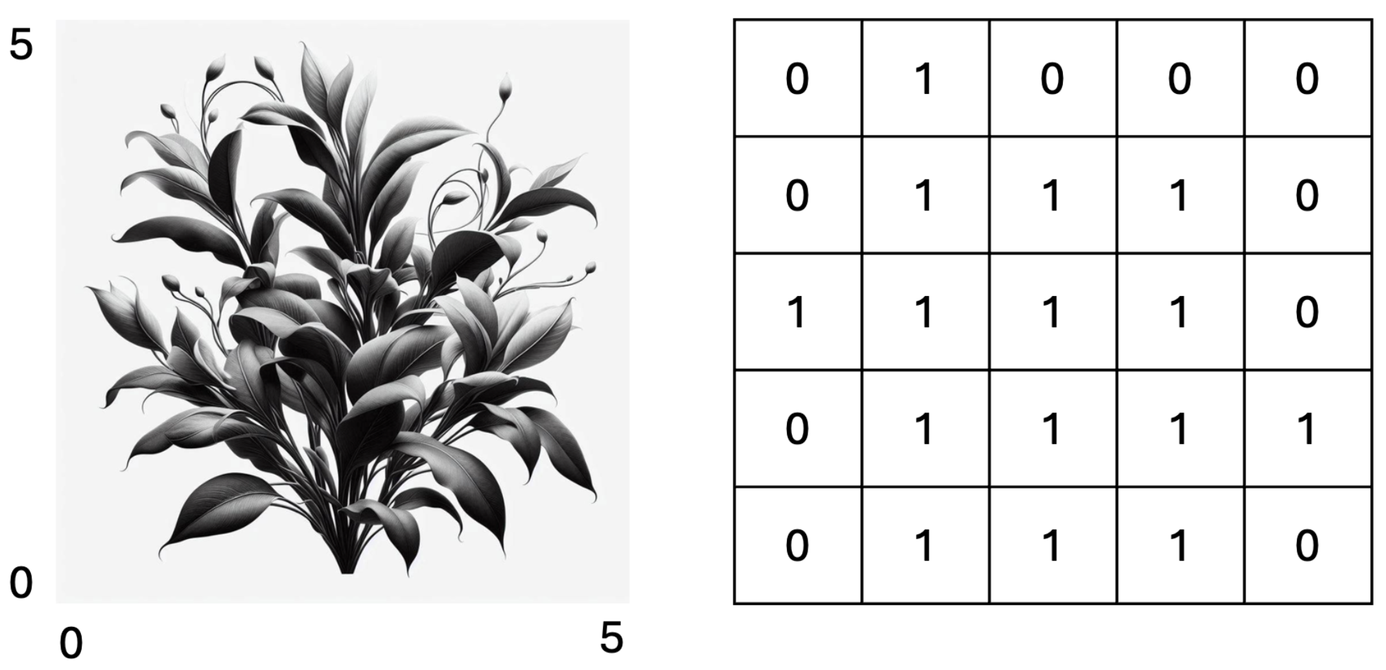
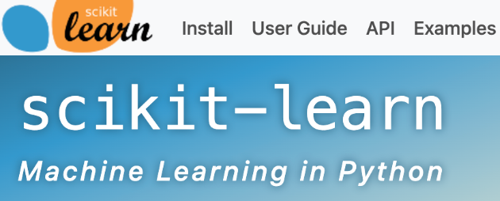
Svm for image classification
Images are represented as 2D arrays
Flattened to 1D vectors
SVM takes:
Flattened images (split into train and test)
Class label for each image
SVC implementation of SVM from the Python sci-kit learn (sklearn) library
What we see
What the computer sees

Slide 6
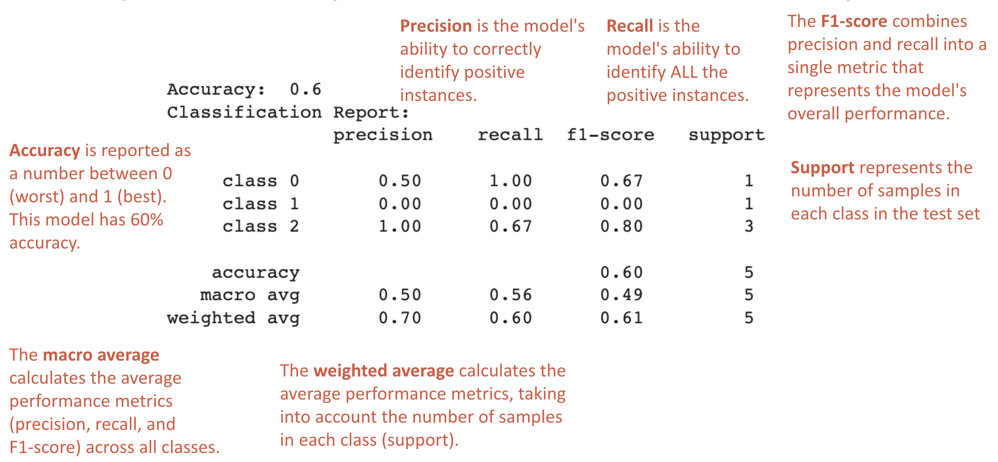
SVM Model Evaluation: Classification REport

Slide 7
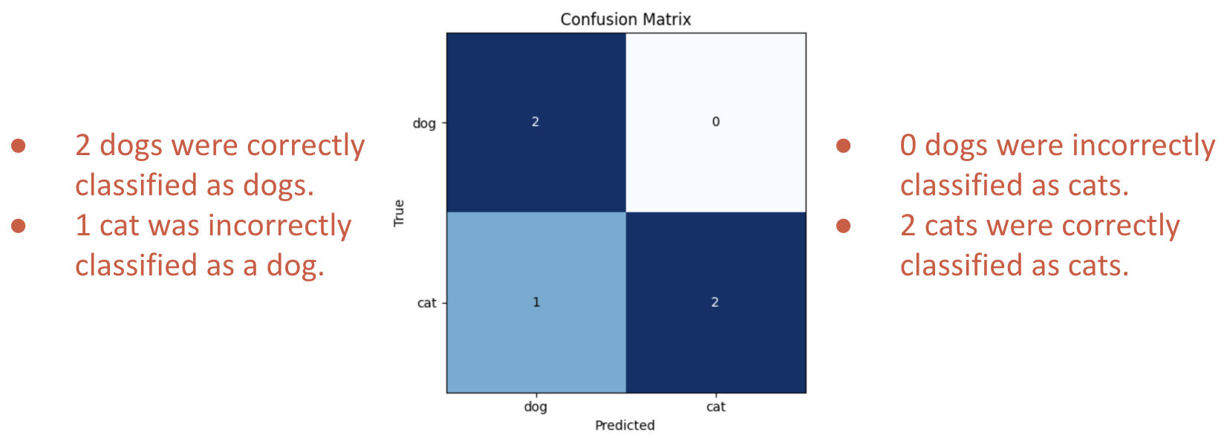
Svm model evaluation: confusion matrix
Assesses performance of a trained classifier model
Compares predicted class labels against the true class labels
Rows = true class labels; columns = predicted class labels

Slide 8
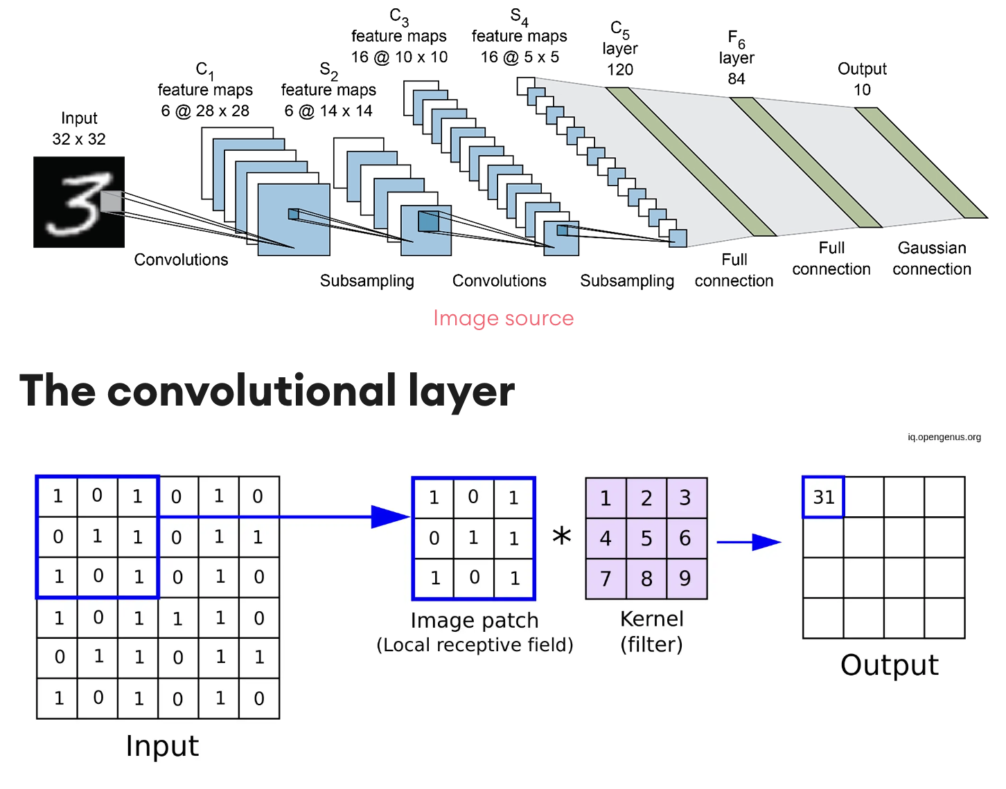
Convolutional neural network (CNN) overview
Feature extraction (edges, shapes) using filters/kernels (small grids) sliding across the image
Convolutional layer: compute the dot product between the filter and the input to get a single value in the output feature map
Activation function: introduces non-linearity to learn complex patterns
Pooling layer: reduces spatial dimensions of the feature maps (e.g. selection of max value from each region)
Flatten feature maps into single vector
Fully connected layer: learn relationships between features and classes. Neurons are fully connected between layers and connection weights adjusted during training.
Softmax function normalizes raw scores to give a probability for each class for that image
CNN Architecture
Convolutional Layer
https://www.superannotate.com/blog/guide-to-convolutional-neural-networks

Slide 9
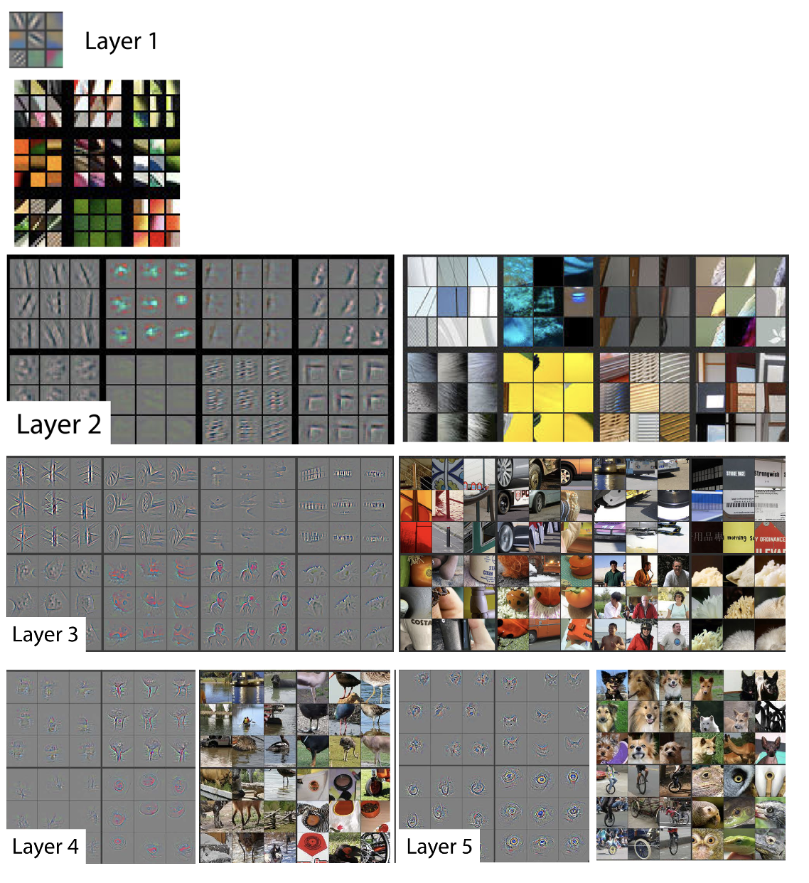
Convolutional layers
Each convolutional layer identifies hierarchical elements of each image in the feature map
Layer 1 - colors
Layer 2 – corners, edge/color conjunction
Layer 3 – textures
Layer 4 – variable, class-specific
Layer 5 – entire objects
https://arxiv.org/pdf/1311.2901

Slide 10
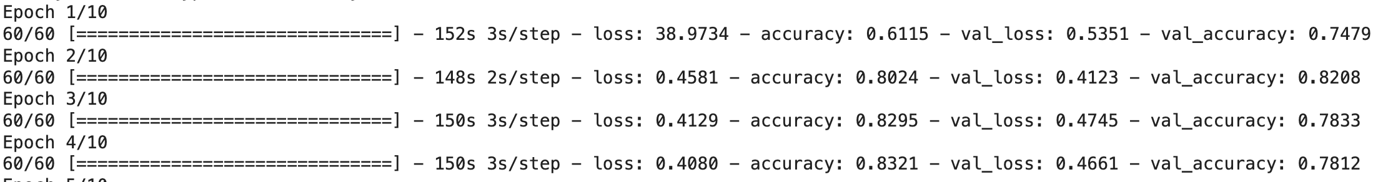
CNN evaluation: model history
During each epoch, the model processes every sample in the training dataset. We set number of epochs as a parameter.
A step is an update of the model’s parameters, which happens after processing a batch of samples. We set batch size as a parameter. Number of steps per epoch is (number of samples in training data) / (batch size).
Loss is calculated for training and validation (test) datasets. Higher model performance = lower loss.
Accuracy is also calculated for training and validation datasets. Use final validation accuracy as the final model accuracy.

Slide 11
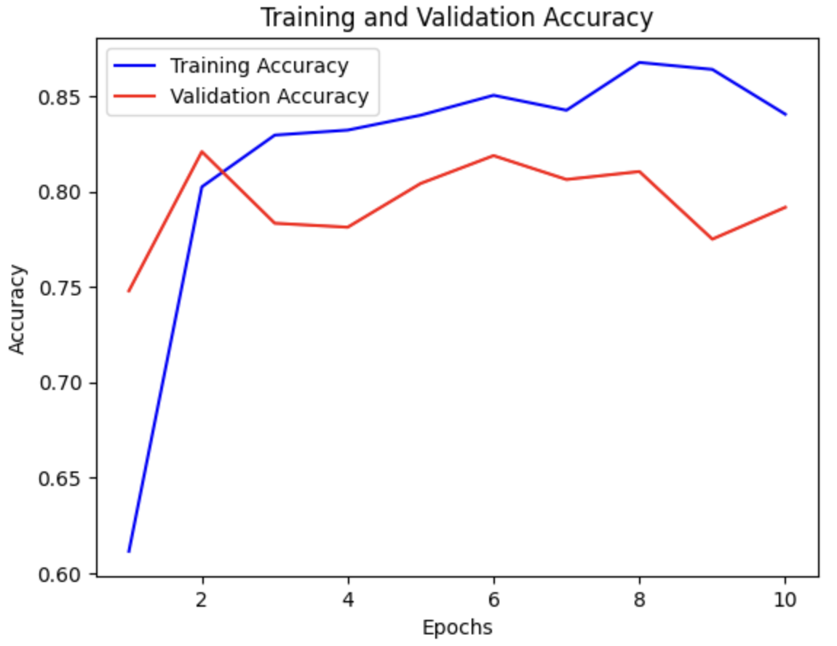
Cnn evaluation: accuracy plots
Examine the history of training and validation accuracy across epochs
Look for signs of overfitting or underfitting
Overfitting:
Training accuracy always increases and is very high
Validation accuracy stops improving or decreases
Underfitting:
Both training and validation accuracy are low
No improvement in either accuracy across many epochs

Slide 12
SVM vs. CNN for image classification
Support Vector Machine
Convolutional Neural Network
Can handle small datasets without overfitting
Performs well on images with simple or easily separable features
Less sensitive to noisy data
More interpretable
Less effective on raw pixel data (do not capture spatial relationships)
Requires large amounts of data
Hierarchical feature extraction performs well on images with complex features
Sensitive to noisy data
Less interpretable
Pre-trained CNN can be fine-tuned for specific tasks

